Slide 2
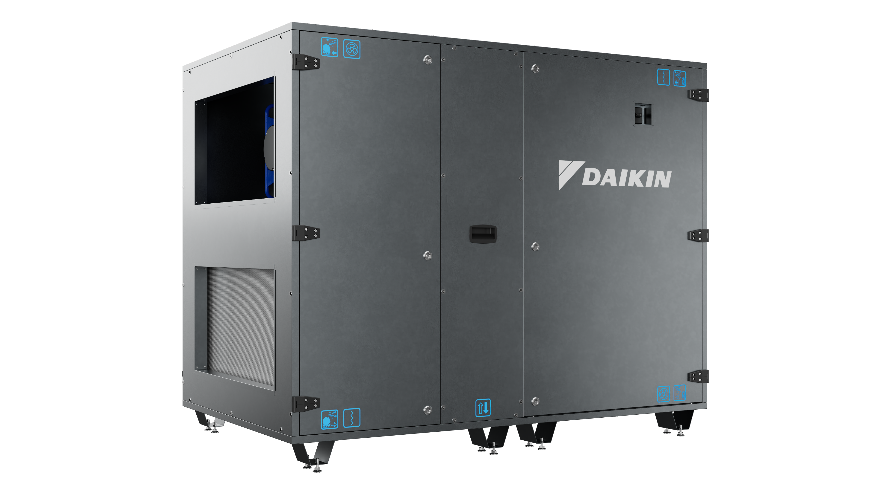
New Daikin AHU range:
Compact R
Smart design, robust engineering &
certified performance
The complete solution for modern ventilation

Slide 3
8 good reasons to choose it

Slide 4
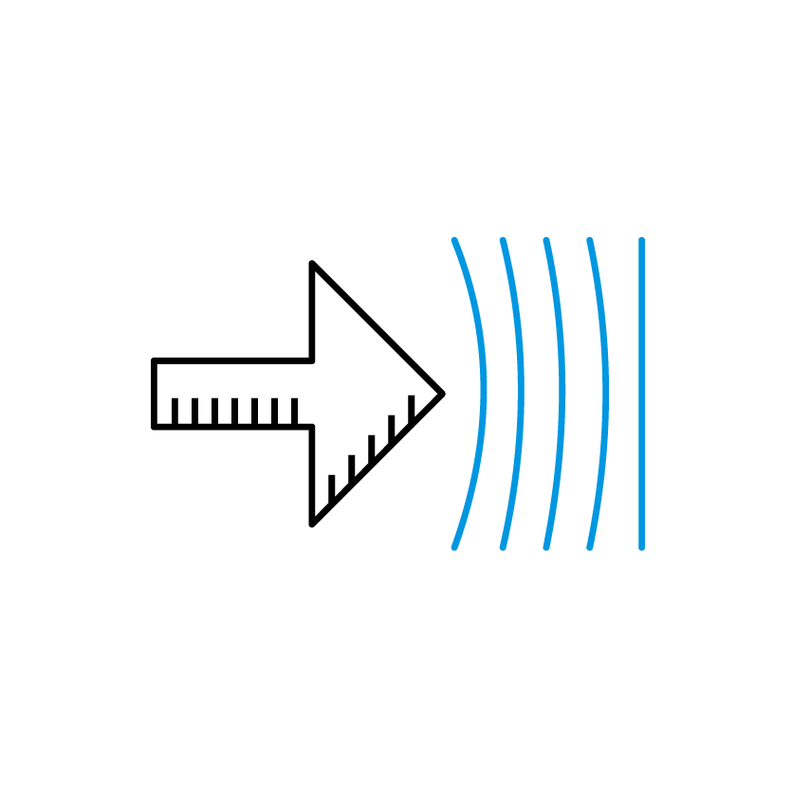
8 good reasons to choose it
1
Designed to fit any application

Slide 5

8 good reasons to choose it
1
Designed to fit any application
2
Fully integrated solution for maximum efficiency

Slide 6

8 good reasons to choose it
1
Designed to fit any application
2
Fully integrated solution for maximum efficiency
3
Cut energy consumption with Heat Recovery

Slide 7

8 good reasons to choose it
1
Designed to fit any application
2
Fully integrated solution for maximum efficiency
3
Cut energy consumption with Heat Recovery
4
Reducing maintenance costs while enabling more efficient operation

Slide 8

8 good reasons to choose it
1
Designed to fit any application
2
Fully integrated solution for maximum efficiency
3
Cut energy consumption with Heat Recovery
5
4
Reliable and cost-effective solution
Reducing maintenance costs while enabling more efficient operation

Slide 9

8 good reasons to choose it
1
Designed to fit any application
2
Fully integrated solution for maximum efficiency
6
3
Eurovent-certified reliability
Cut energy consumption with Heat Recovery
5
4
Reliable and cost-effective solution
Reducing maintenance costs while enabling more efficient operation

Slide 10
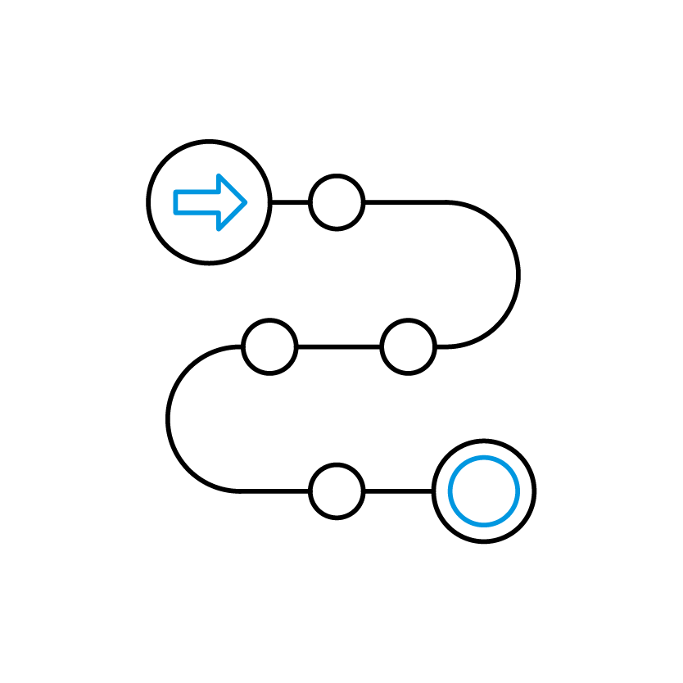
8 good reasons to choose it
1
Designed to fit any application
7
2
Fast delivery for an easy &
flexible installation
Fully integrated solution for maximum efficiency
6
3
Eurovent-certified reliability
Cut energy consumption with Heat Recovery
5
4
Reliable and cost-effective solution
Reducing maintenance costs while enabling more efficient operation

Slide 11

8 good reasons to choose it
8
1
Optimized Indoor Air Quality with performance monitoring
Designed to fit any application
7
2
Fast delivery for an easy &
flexible installation
Fully integrated solution for maximum efficiency
6
3
Eurovent-certified reliability
Cut energy consumption with Heat Recovery
5
4
Reliable and cost-effective solution
Reducing maintenance costs while enabling more efficient operation

