Slide 2
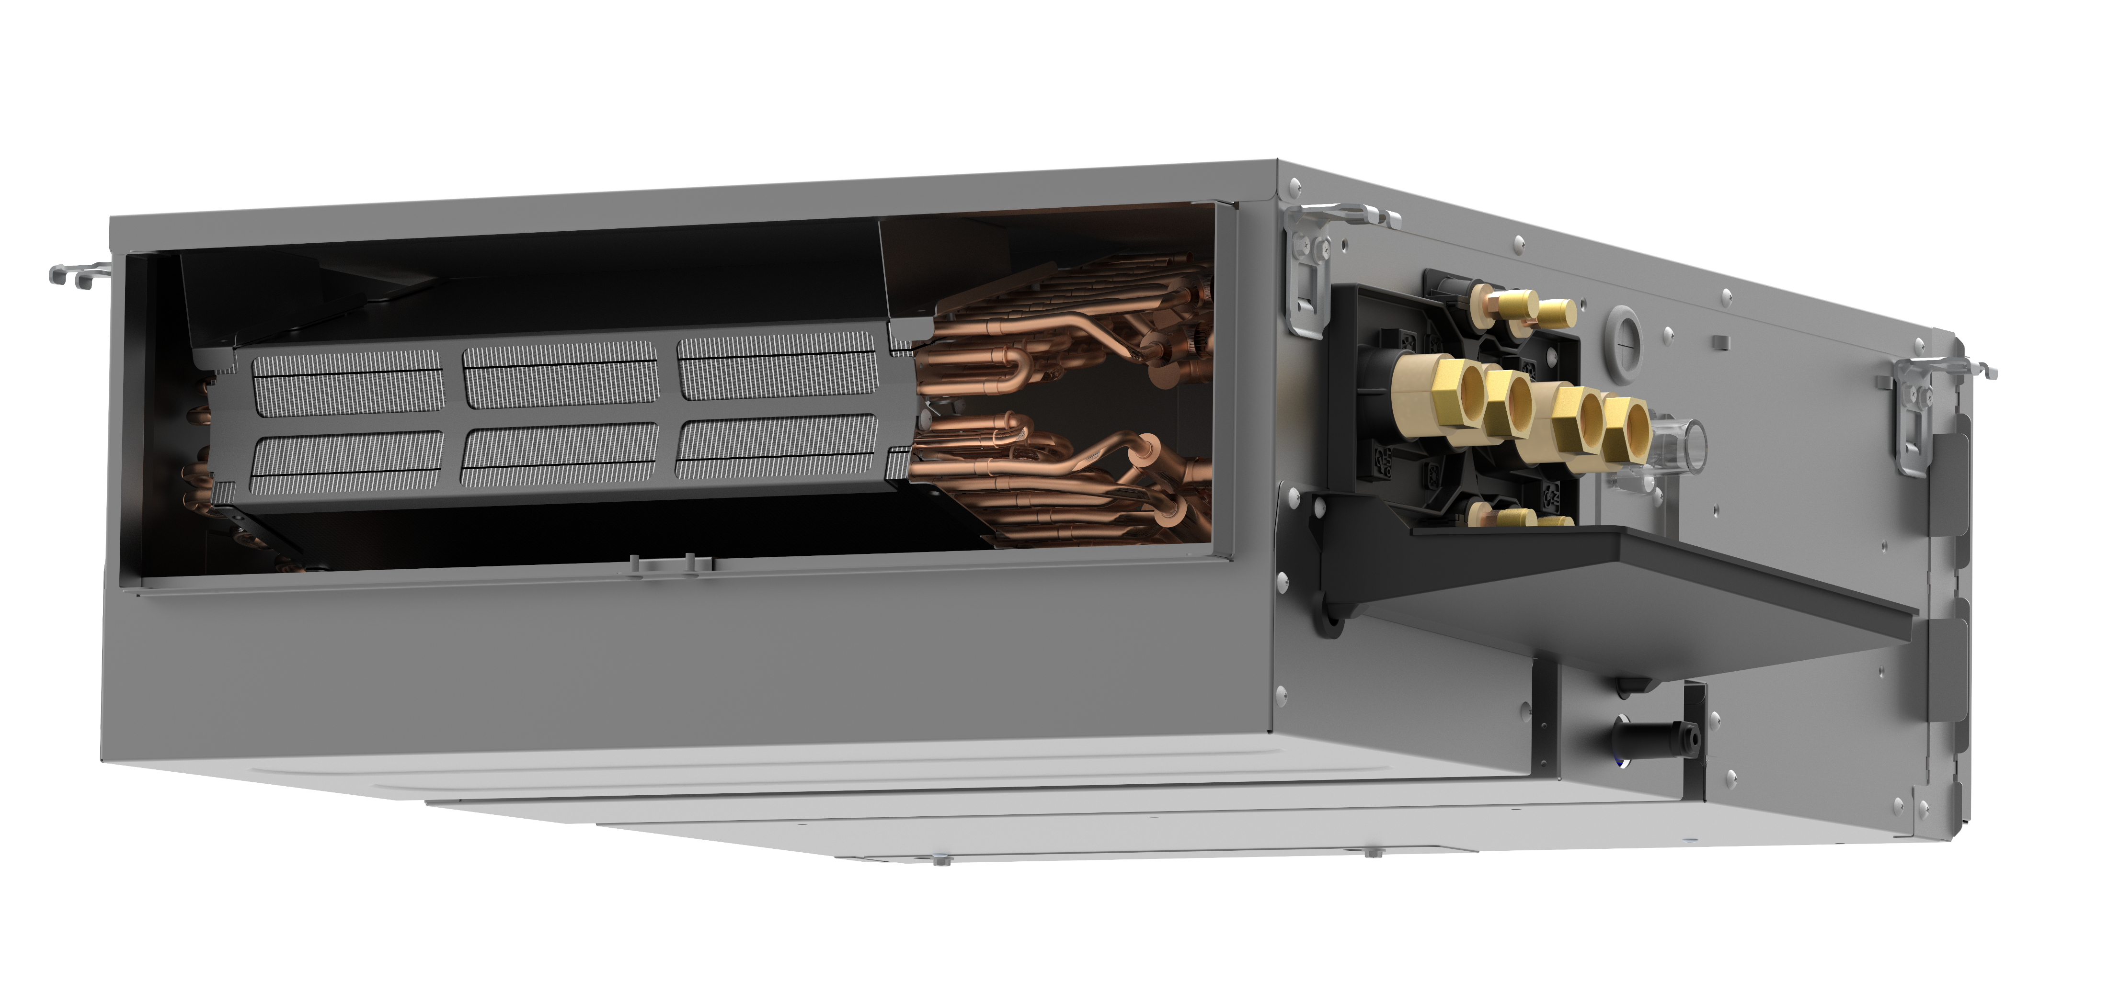
New Daikin Fan Coil unit:
FWQ-A
BLDC fan motor and open protocol control capability
Versatile & high-performance solution tailored for comfort

Slide 3
6 good reasons to choose it

Slide 4

6 good reasons to choose it
1
Improved cooling performance

Slide 5

6 good reasons to choose it
1
Improved cooling performance
2
Brushless Direct Current motor
for high comfort &
lower operating costs

Slide 6

6 good reasons to choose it
1
Improved cooling performance
2
Brushless Direct Current motor
for high comfort &
lower operating costs
3
Open protocol communication for efficient system management

Slide 7

6 good reasons to choose it
4
1
Easy & fast plug-and-play installation
Improved cooling performance
2
Brushless Direct Current motor
for high comfort &
lower operating costs
3
Open protocol communication for efficient system management

Slide 8

6 good reasons to choose it
4
1
Easy & fast plug-and-play installation
Improved cooling performance
5
2
Flexible Air Filtration Solutions for Every Environment
Brushless Direct Current motor
for high comfort &
lower operating costs
3
Open protocol communication for efficient system management

Slide 9

6 good reasons to choose it
4
1
Easy & fast plug-and-play installation
Improved cooling performance
5
2
Flexible Air Filtration Solutions for Every Environment
Brushless Direct Current motor
for high comfort &
lower operating costs
6
3
Advanced Control for Smarter, More Efficient System Management
Open protocol communication for efficient system management

