Slide 2
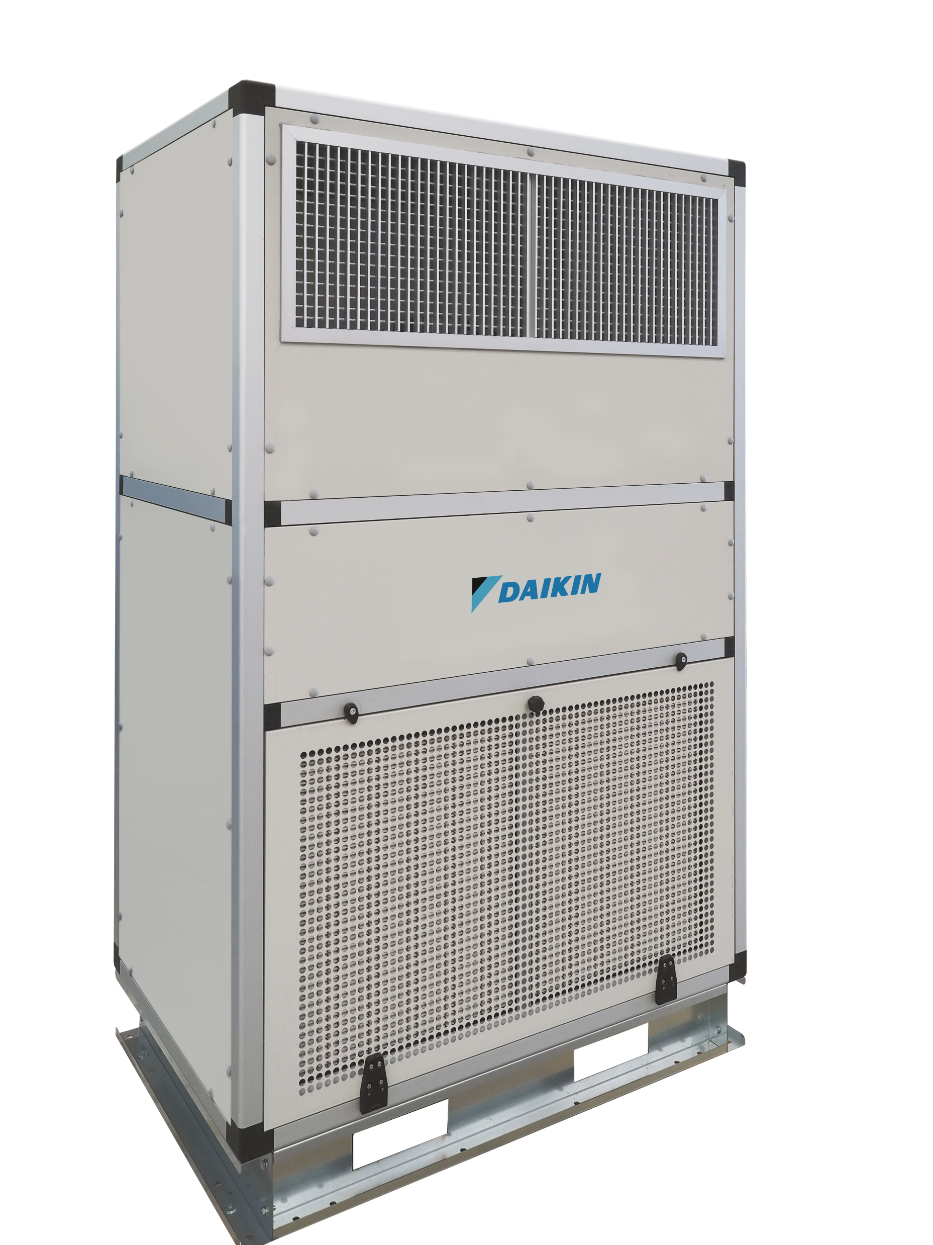
New Vertical DX AHU
Smart Design, Maximum Efficiency

Slide 3
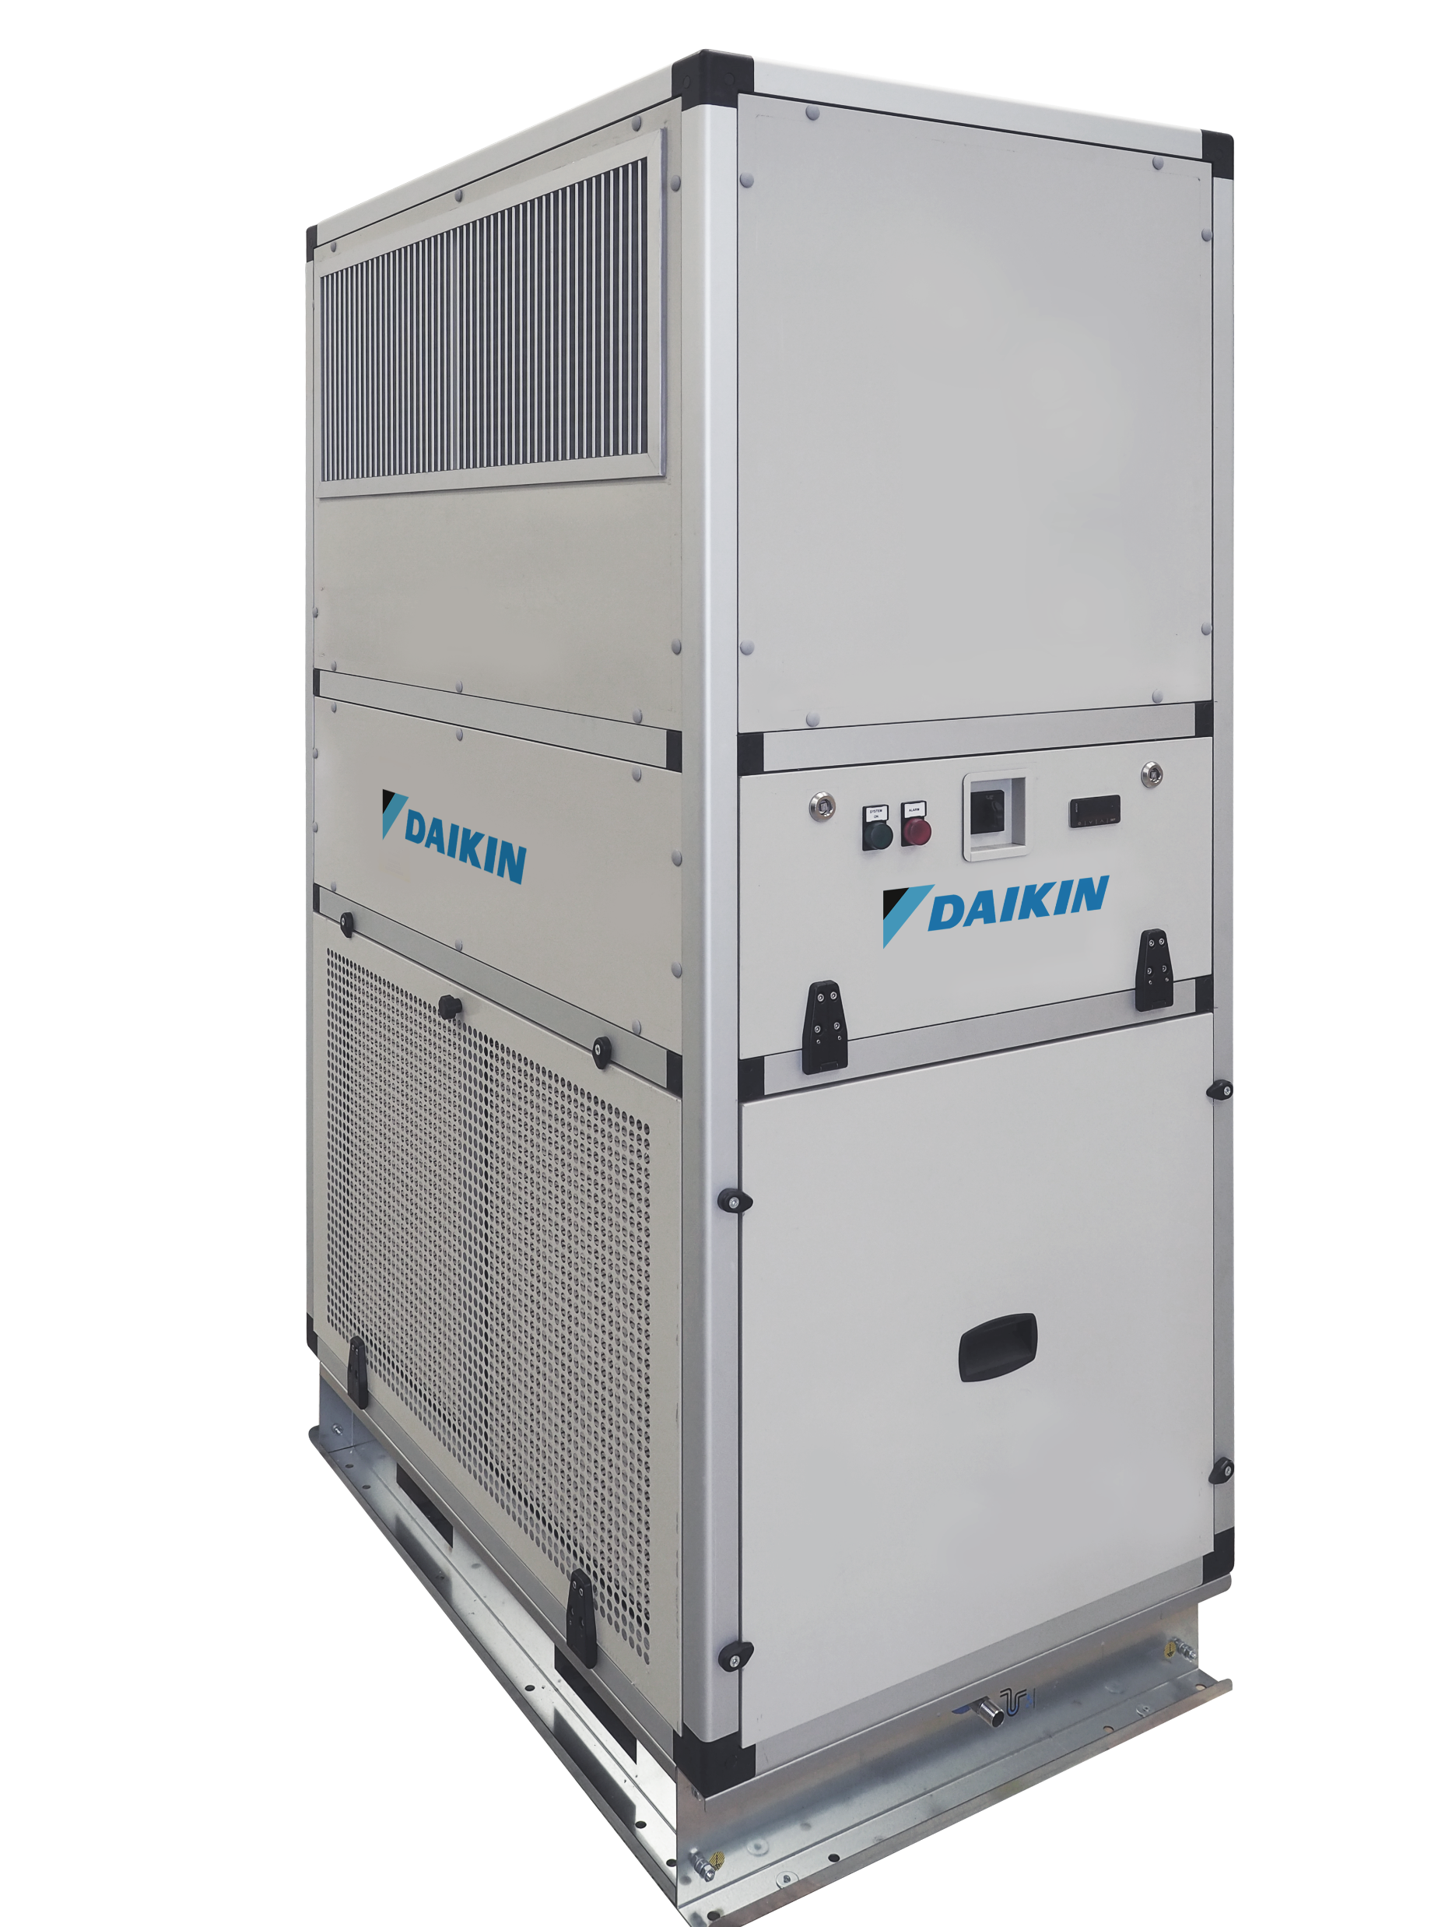
6 good reasons to choose it

Slide 4
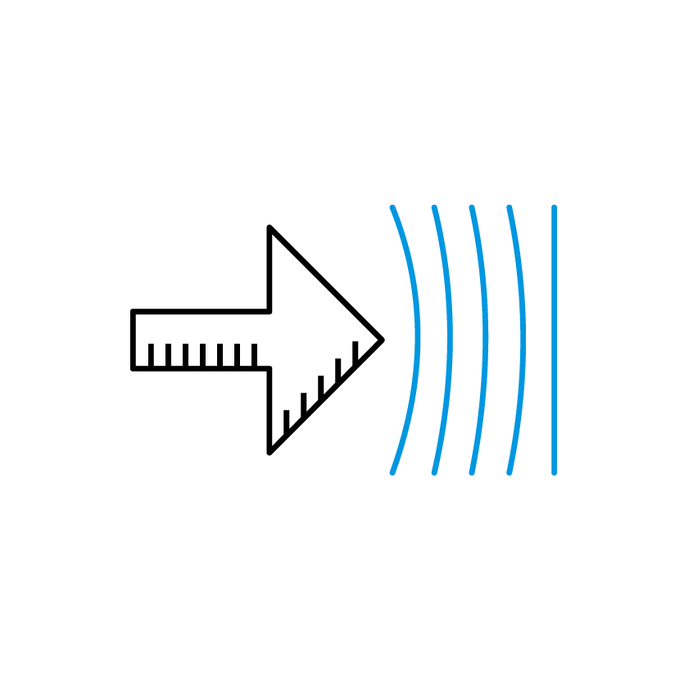
6 good reasons to choose it
1
Smart design for installation flexibility

Slide 5
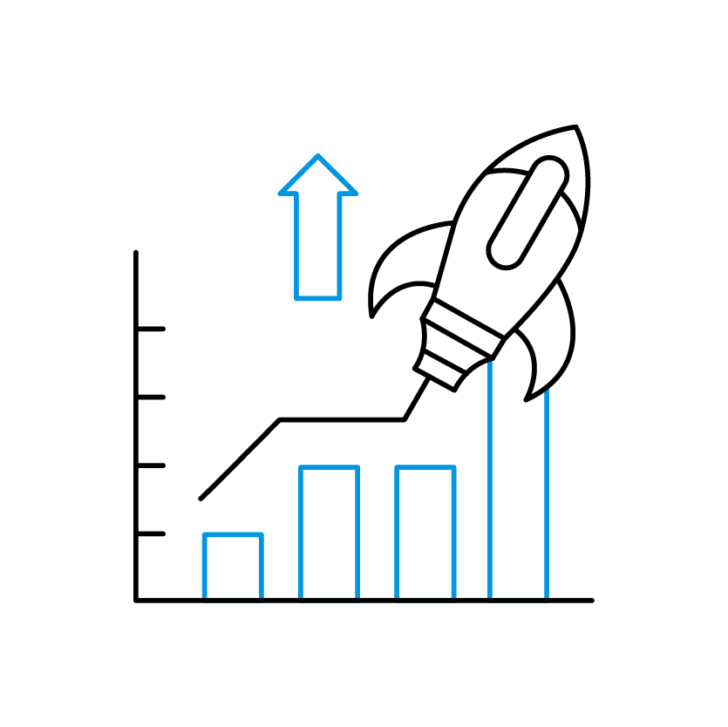
6 good reasons to choose it
1
Smart design for installation flexibility
2
Integrated DX solution for high energy efficiency

Slide 6

6 good reasons to choose it
1
Smart design for installation flexibility
2
Integrated DX solution for high energy efficiency
3
Optimised performance across all seasons

Slide 7

6 good reasons to choose it
1
Smart design for installation flexibility
2
Integrated DX solution for high energy efficiency
4
3
Advanced control and scalable connectivity
Optimised performance across all seasons

Slide 8

6 good reasons to choose it
1
Smart design for installation flexibility
5
2
Reduced carbon footprint and retrofit readiness
Integrated DX solution for high energy efficiency
4
3
Advanced control and scalable connectivity
Optimised performance across all seasons

Slide 9
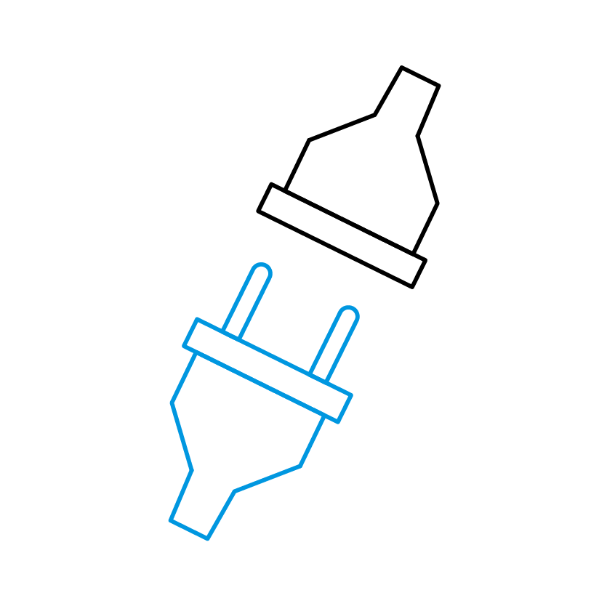
6 good reasons to choose it
6
1
Plug & play installation
Smart design for installation flexibility
5
2
Reduced carbon footprint and retrofit readiness
Integrated DX solution for high energy efficiency
4
3
Advanced control and scalable connectivity
Optimised performance across all seasons

