Slide 2
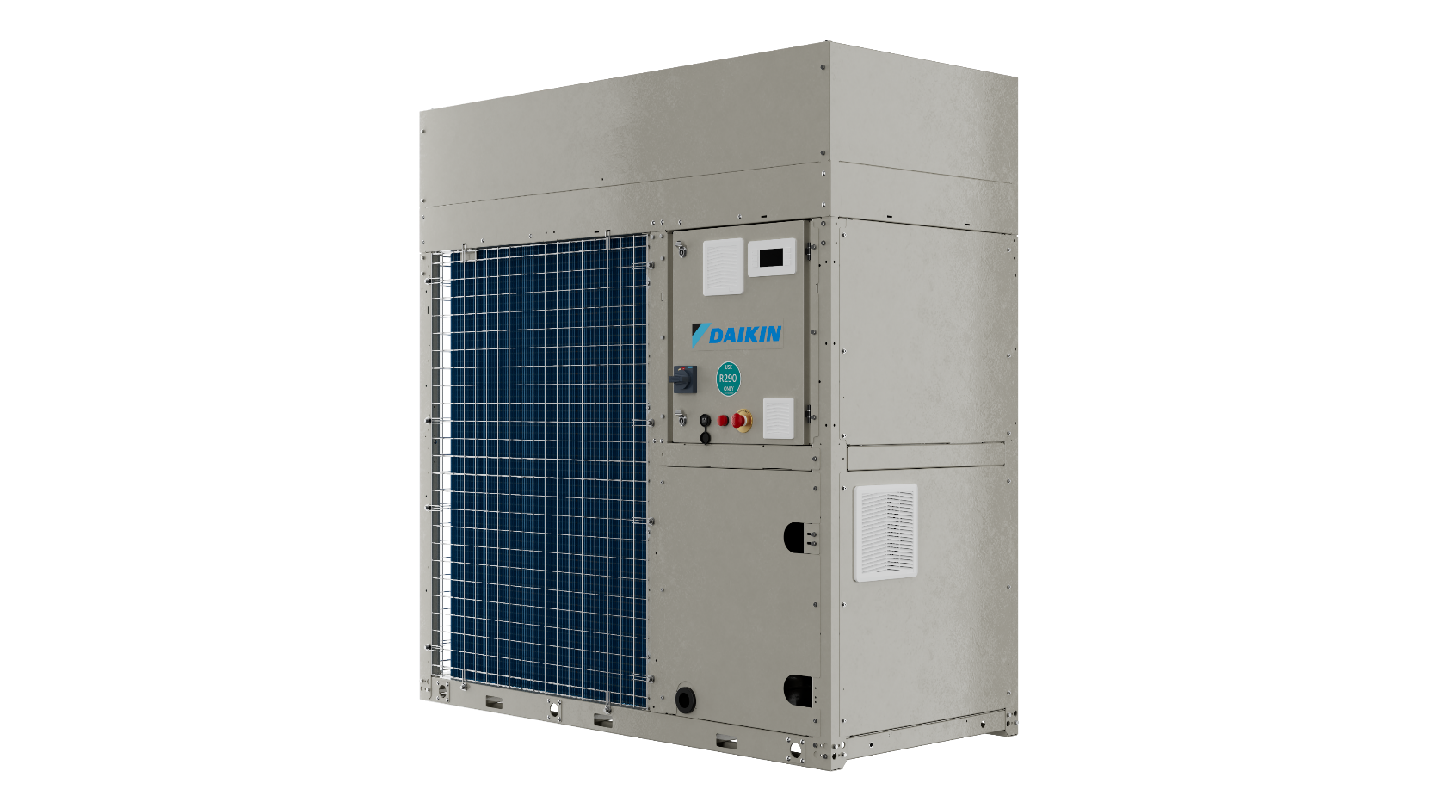
New EWA/YK‑CZ
R-290 Chiller & Heat Pump
Compact and air-to-water
monobloc unit

Slide 3
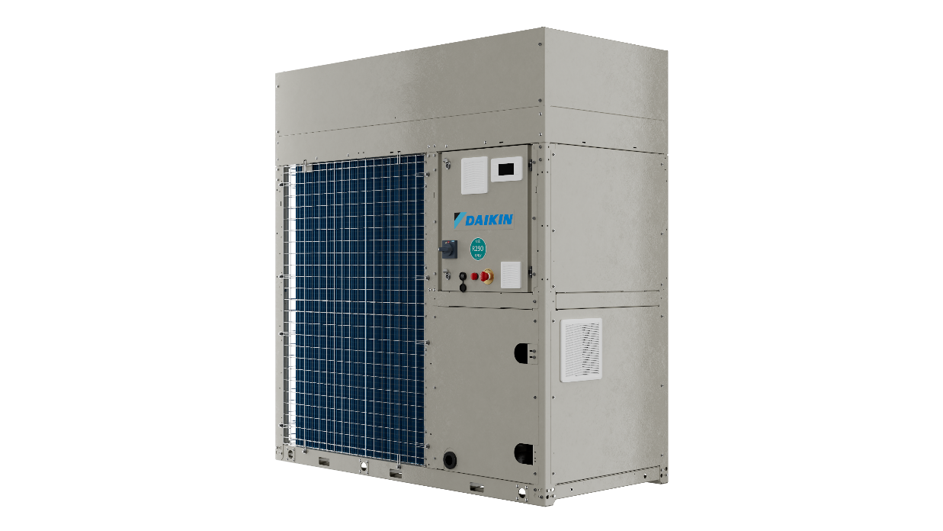
5 good reasons to choose it
Notes:
Today we’re looking at the new EWA/YK-CZ range, based on R-290.
A compact, air-to-water monobloc solution designed to deliver high efficiency, simplified installation and immediate availability for a wide range of applications.
Let’s go straight to the five reasons why this range represents a practical step forward in sustainable HVAC design.

Slide 4


Explore Our Webinars: Watch Past Sessions & Discover What’s Next
Scan here

Slide 5

5 good reasons to choose it
1
Use of a fully
natural refrigerant
Notes:
1. Use of a fully natural refrigerant
EWA/YK-CZ uses R-290, a fully natural refrigerant with ultra-low GWP.
But this is not only about compliance with current regulations.
It is about anticipating what comes next.
R-290 enables consultants and building owners to align with long-term decarbonisation targets, while maintaining high performance and system efficiency.
At the same time, using propane requires a different approach to system design.
And this is where the second reason becomes essential.

Slide 6

5 good reasons to choose it
1
Use of a fully
natural refrigerant
2
Daikin Safety Shield with integrated safety functions
Notes:
2. Daikin Safety Shield – integrated safety functions
When working with A3 refrigerants, safety cannot be treated as an additional feature.
It must be designed into the unit from the very beginning.
This is the principle behind the Daikin Safety Shield.
A multi-layer safety concept that combines electrical design and refrigerant and hydronic circuit protection into a single, coherent approach.
Let’s start with the electrical side.

Slide 7

Daikin Safety Shield: Electrical box safety design
Indipendent power supply
for safety components

Slide 8

Daikin Safety Shield: Electrical box safety design
Indipendent power supply
for safety components
ATEX certified fans

Slide 9

Daikin Safety Shield: Electrical box safety design
Indipendent power supply
for safety components
Siren for visual & acoustic alert
ATEX certified fans

Slide 10
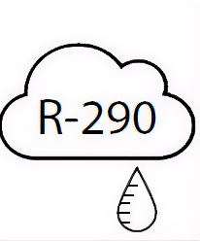
Daikin Safety Shield: Electrical box safety design
Leak detector
Indipendent power supply
for safety components
Siren for visual & acoustic alert
ATEX certified fans

Slide 11
Daikin Safety Shield: Refrigerant & hydronic circuits
Leak detector

Slide 12
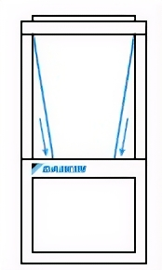
Daikin Safety Shield: Refrigerant & hydronic circuits
Leak detector
Coil covers

Slide 13
Daikin Safety Shield: Refrigerant & hydronic circuits
Leak detector
Coil covers
ATEX certified fans

Slide 14
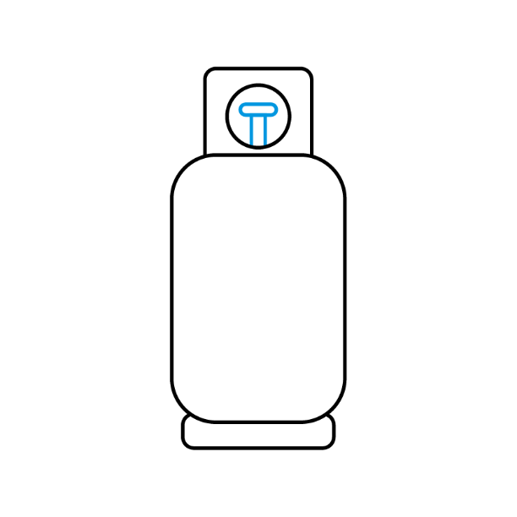
Daikin Safety Shield: Refrigerant & hydronic circuits
Leak detector
Coil covers
Refrigerant storage tanks
ATEX certified fans

Slide 15

Daikin Safety Shield: Refrigerant & hydronic circuits
Leak detector
Safety valve manifold
Coil covers
Refrigerant storage tanks
ATEX certified fans

Slide 16
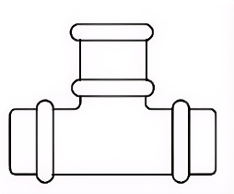
Daikin Safety Shield: Refrigerant & hydronic circuits
Water leak box to separate propane from water
Leak detector
Safety valve manifold
Coil covers
Refrigerant storage tanks
ATEX certified fans

Slide 17

5 good reasons to choose it
1
Use of a fully
natural refrigerant
2
Daikin Safety Shield with integrated safety functions
3
Heat pump version delivers hot water up to 75 °C
Notes:
3. Heat pump version delivers hot water up to 75°C
The heat pump version of the EWA/YK-CZ range can deliver hot water up to 75°C.
This makes it particularly suitable for heating applications and boiler replacement scenarios.
It allows integration into existing systems without major changes to emitters or hydraulic distribution.
So it becomes a practical solution for retrofit projects, where decarbonisation needs to be achieved with minimal disruption.

Slide 18


5 good reasons to choose it
1
Use of a fully
natural refrigerant
2
Daikin Safety Shield with integrated safety functions
4
3
Inverter‑driven scroll compressors and EC brushless fans
Heat pump version delivers hot water up to 75 °C
Notes:
4. Inverter-driven scroll compressors and EC brushless fans
Efficiency is not only defined at nominal conditions.
The EWA/YK-CZ range features inverter-driven scroll compressors, developed and manufactured by Daikin, combined with EC brushless fans.
This ensures precise capacity control and optimised operation at partial load, where systems spend most of their operating time.
The result is improved seasonal efficiency, stable operation and increased reliability.
Because when core components are designed and controlled in-house, system performance can be optimised at every level.

Slide 19
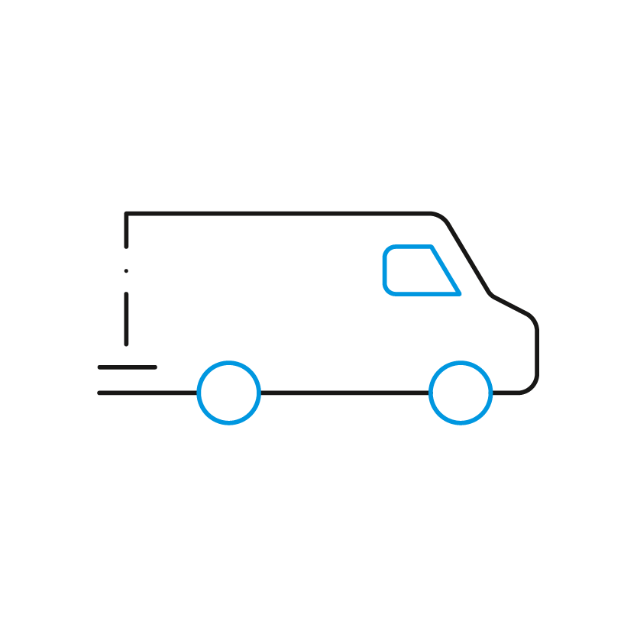
5 good reasons to choose it
5
1
Fast stock availability!
Use of a fully
natural refrigerant
2
Daikin Safety Shield with integrated safety functions
4
3
Inverter‑driven scroll compressors and EC brushless fans
Heat pump version delivers hot water up to 75 °C
Notes:
5. Fast stock availability
Finally, availability.
The EWA/YK-CZ range is designed to be readily available from stock.
This has a direct impact on project timelines.
Shorter lead times mean faster decision-making, quicker installation and reduced delays on site.
In many applications, this is not just a logistical advantage — it is a key selection factor.
So, these are the five reasons why EWA/YK-CZ represents more than just a compact heat pump.
It combines a natural refrigerant, engineered safety, high-temperature capability and efficient operation in a solution that is ready to be deployed.
For consultants and installers, this means a balance between sustainability, simplicity and availability.
A solution that is not only future-ready, but also immediately applicable.
Thank you for joining us for this edition of 5 Minutes with Daikin

Slide 20

Scan the QR code
to download the presentation

