Slide 2
EWWH-VZ high-temperature heat pump

Slide 3
6 good reasons to choose it

Slide 4

Enabling decarbonization of heating systems
#1
Sustainability

Slide 5
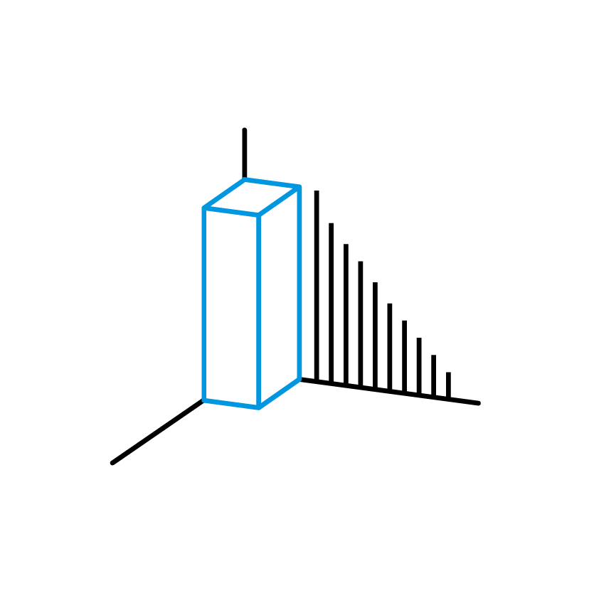
Enabling the system to be installed in limited spaces
#1
Sustainability
#2
Flexible installation for compact spaces

Slide 6

Optimization of running costs
#1
Sustainability
#2
Flexible installation for compact spaces
#3
Advanced efficiency through VVR & Inverter technology

Slide 7

Maximum reliability
#1
Sustainability
#2
Flexible installation for compact spaces
#4
Consistent operational continuity
#3
Advanced efficiency through VVR & Inverter technology

Slide 8

Local presence, rapid and remote support
#1
Sustainability
#5
After-sales services
#2
Flexible installation for compact spaces
#4
Consistent operational continuity
#3
Advanced efficiency through VVR & Inverter technology

Slide 9

Ensuring quality through Factory Acceptance Testing (FAT)
#6
Ensuring performance peace of mind
#1
Sustainability
#5
After-sales services
#2
Flexible installation for compact spaces
#4
Consistent operational continuity
#3
Advanced efficiency through VVR & Inverter technology

