Slide 2
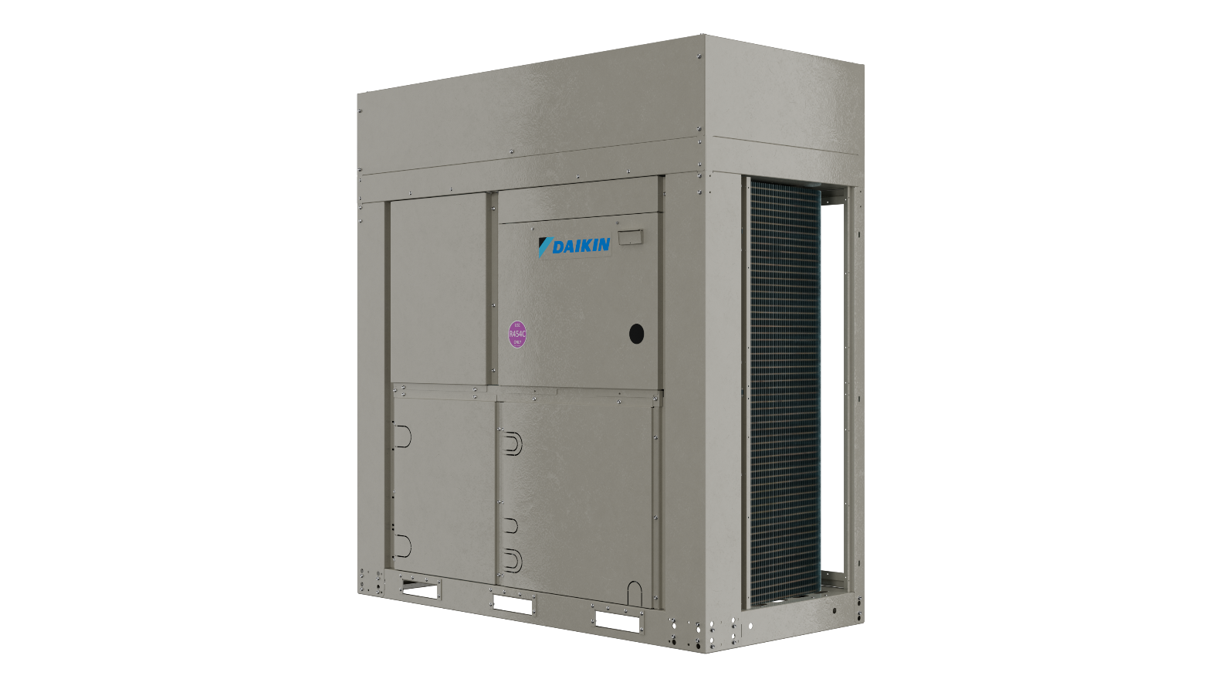
Daikin Air to Water Inverter heat pump EWYE-CZ
with R454C refrigerant
High temperature & low carbon solution for heating Decarbonization

Slide 3
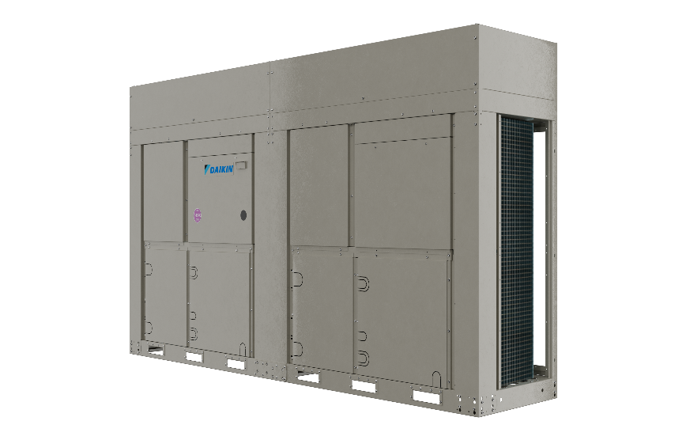
10 good reasons to choose it

Slide 4
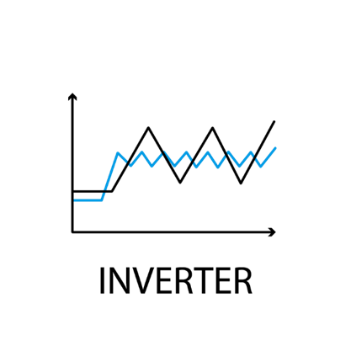


10 good reasons to choose it
#1
Daikin full Inverter technology ensures high efficiency & low running costs
Scroll compressor
Fan motor

Slide 5

10 good reasons to choose it
#1
Daikin full Inverter technology ensures high efficiency & low running costs
#2
Vapour Injection technology allowing high-temperature & hot water production
Up to 70 °C

Slide 6

10 good reasons to choose it
#1
Daikin full Inverter technology ensures high efficiency & low running costs
#2
Vapour Injection technology allowing high-temperature & hot water production
#3
Smart control of defrosting for maximum customer comfort

Slide 7

10 good reasons to choose it
#1
Daikin full Inverter technology ensures high efficiency & low running costs
#2
Vapour Injection technology allowing high-temperature & hot water production
#3
Smart control of defrosting for maximum customer comfort
#4
Daikin technology ensures reliability & customer peace of mind

Slide 8
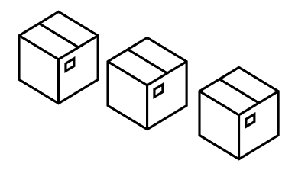
10 good reasons to choose it
#1
Daikin full Inverter technology ensures high efficiency & low running costs
#2
Vapour Injection technology allowing high-temperature & hot water production
#3
Smart control of defrosting for maximum customer comfort
#4
Daikin technology ensures reliability & customer peace of mind
#5
Stock availability

Slide 9

10 good reasons to choose it
#1
Daikin full Inverter technology ensures high efficiency & low running costs
#2
Vapour Injection technology allowing high-temperature & hot water production
#3
Smart control of defrosting for maximum customer comfort
Daikin onSite
#4
Daikin technology ensures reliability & customer peace of mind
#6
Remote monitoring & system optimization
#5
Stock availability

Slide 10

10 good reasons to choose it
#1
Daikin full Inverter technology ensures high efficiency & low running costs
#2
Vapour Injection technology allowing high-temperature & hot water production
#3
Smart control of defrosting for maximum customer comfort
#7
Smart Grid Ready Box to run on green energy
#4
Daikin technology ensures reliability & customer peace of mind
#6
Remote monitoring & system optimization
#5
Stock availability

Slide 11


10 good reasons to choose it
#1
Daikin full Inverter technology ensures high efficiency & low running costs
#2
Vapour Injection technology allowing high-temperature & hot water production
#8
Green Building contribution & compliant with F-Gas regulations
#3
Smart control of defrosting for maximum customer comfort
#7
Smart Grid Ready Box to run on green energy
#4
Daikin technology ensures reliability & customer peace of mind
#6
Remote monitoring & system optimization
#5
Stock availability

Slide 12
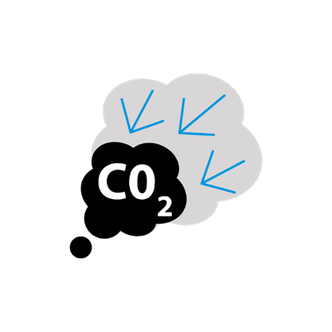
10 good reasons to choose it
#1
Daikin full Inverter technology ensures high efficiency & low running costs
#9
Low carbon solution
#2
Vapour Injection technology allowing high-temperature & hot water production
#8
Green Building contribution & compliant with F-Gas regulations
#3
Smart control of defrosting for maximum customer comfort
#7
Smart Grid Ready Box to run on green energy
#4
Daikin technology ensures reliability & customer peace of mind
#6
Remote monitoring & system optimization
#5
Stock availability

Slide 13

10 good reasons to choose it
#10
Flexible configuration with/without hydronic kit
#1
Daikin full Inverter technology ensures high efficiency & low running costs
#9
Low carbon solution
#2
Vapour Injection technology allowing high-temperature & hot water production
#8
Green Building contribution & compliant with F-Gas regulations
#3
Smart control of defrosting for maximum customer comfort
#7
Smart Grid Ready Box to run on green energy
#4
Daikin technology ensures reliability & customer peace of mind
#6
Remote monitoring & system optimization
#5
Stock availability

