Slide 2
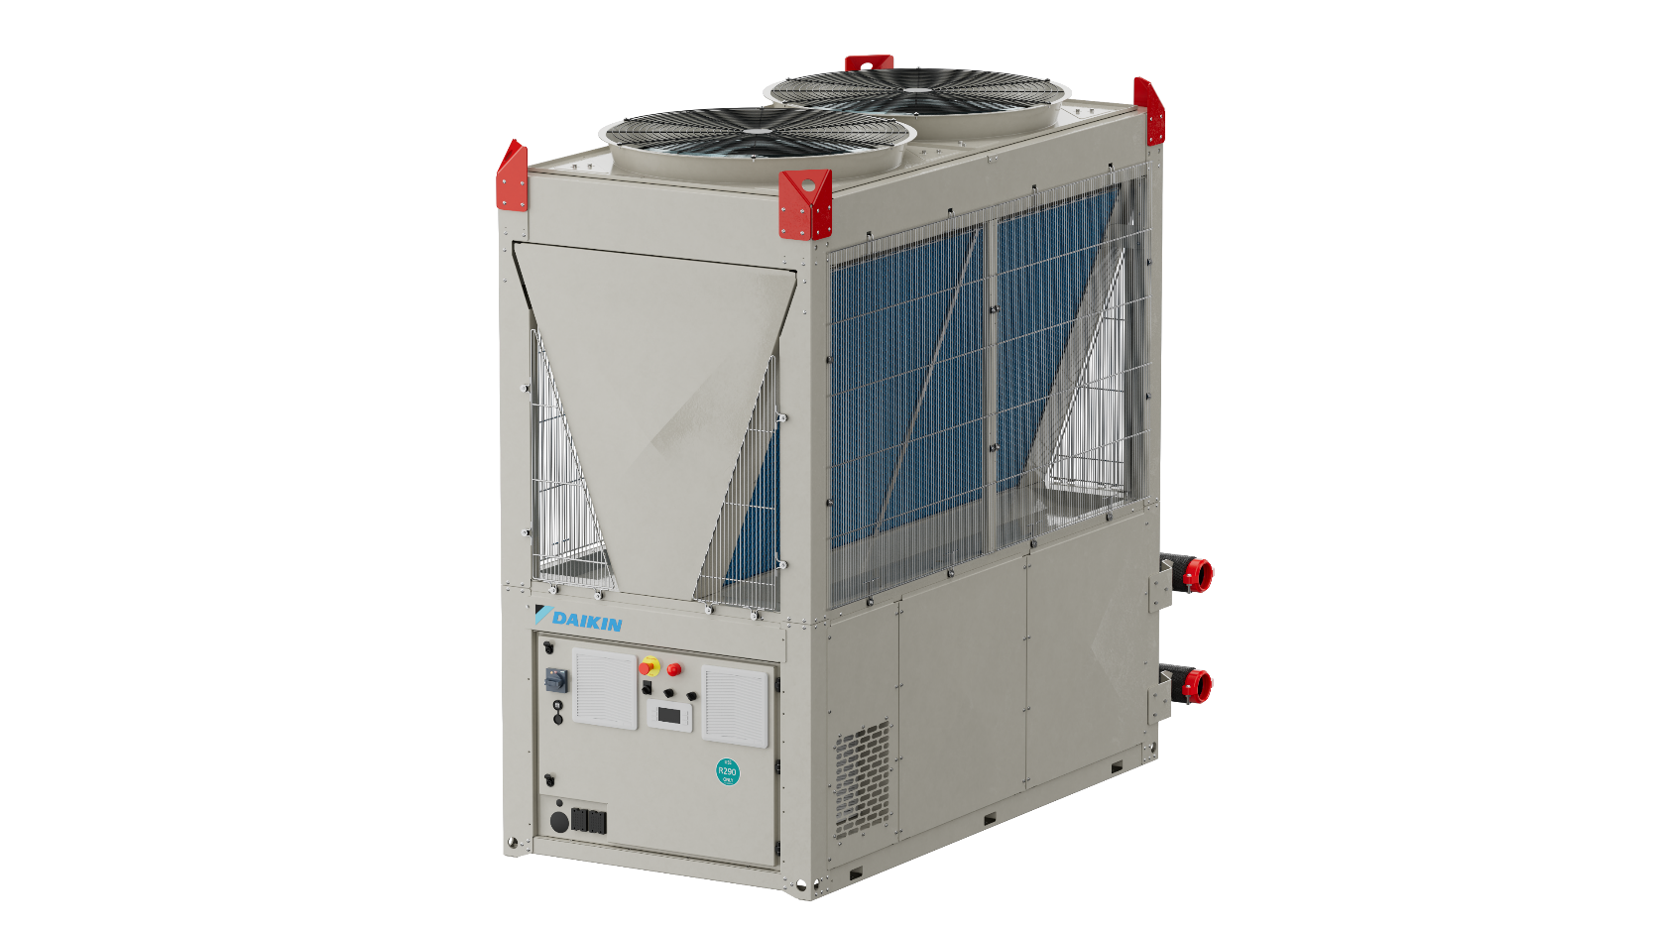
New EWYK-QZ
R-290 Heat Pump
modularity up to 2000 kW for
resilience & operational continuity

Slide 3


Explore Our Webinars: Watch Past Sessions & Discover What’s Next
Scan here

Slide 4
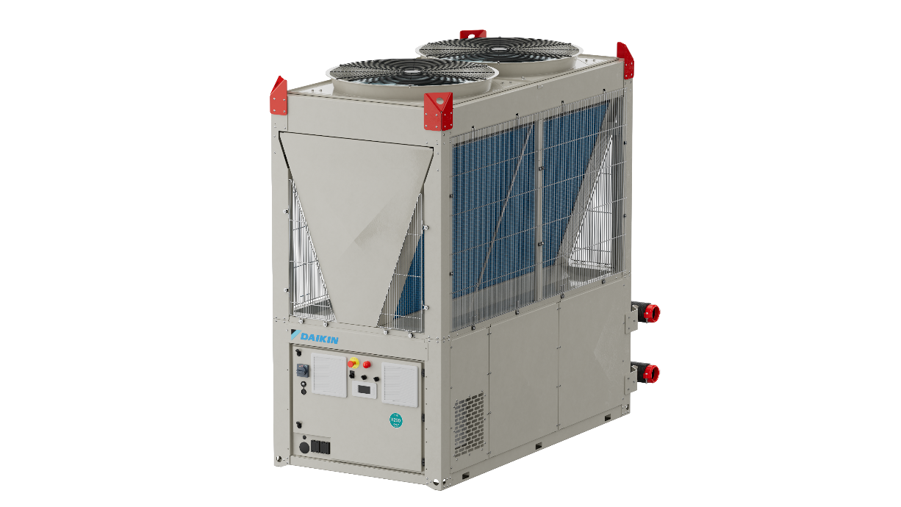
8 good reasons to choose it

Slide 5

8 good reasons to choose it
1
Use of a fully
natural refrigerant

Slide 6

8 good reasons to choose it
1
Use of a fully
natural refrigerant
2
Daikin Safety Shield with integrated safety functions

Slide 7

Daikin Safety Shield: Electrical box safety design
Indipendent power supply
for safety components

Slide 8

Daikin Safety Shield: Electrical box safety design
Indipendent power supply
for safety components
ATEX certified fans

Slide 9

Daikin Safety Shield: Electrical box safety design
Indipendent power supply
for safety components
Siren for visual & acoustic alert
ATEX certified fans

Slide 10
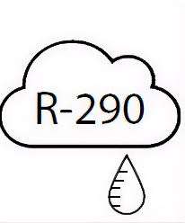
Daikin Safety Shield: Electrical box safety design
Leak detector
Indipendent power supply
for safety components
Siren for visual & acoustic alert
ATEX certified fans

Slide 11
Daikin Safety Shield: Refrigerant & hydronic circuits
Leak detector

Slide 12
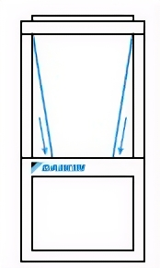
Daikin Safety Shield: Refrigerant & hydronic circuits
Leak detector
Coil covers

Slide 13
Daikin Safety Shield: Refrigerant & hydronic circuits
Leak detector
Coil covers
ATEX certified fans

Slide 14
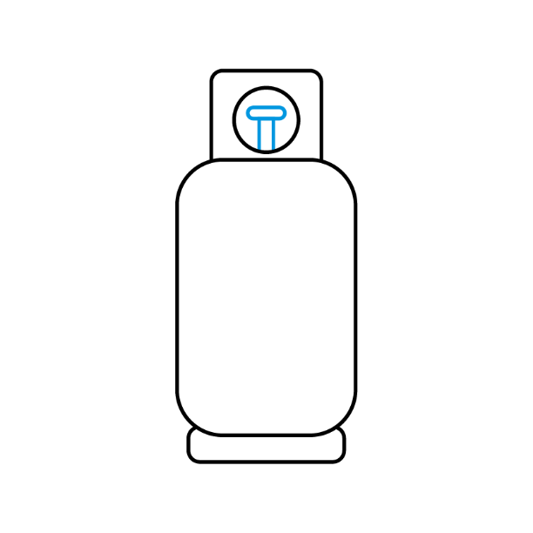
Daikin Safety Shield: Refrigerant & hydronic circuits
Leak detector
Coil covers
Refrigerant storage tanks
ATEX certified fans

Slide 15

Daikin Safety Shield: Refrigerant & hydronic circuits
Leak detector
Safety valve manifold
Coil covers
Refrigerant storage tanks
ATEX certified fans

Slide 16
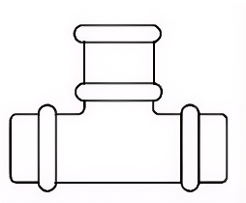
Daikin Safety Shield: Refrigerant & hydronic circuits
Water leak box to separate propane from water
Leak detector
Safety valve manifold
Coil covers
Refrigerant storage tanks
ATEX certified fans

Slide 17

8 good reasons to choose it
1
Use of a fully
natural refrigerant
2
Daikin Safety Shield with integrated safety functions
3
Modular multi‑array architecture

Slide 18
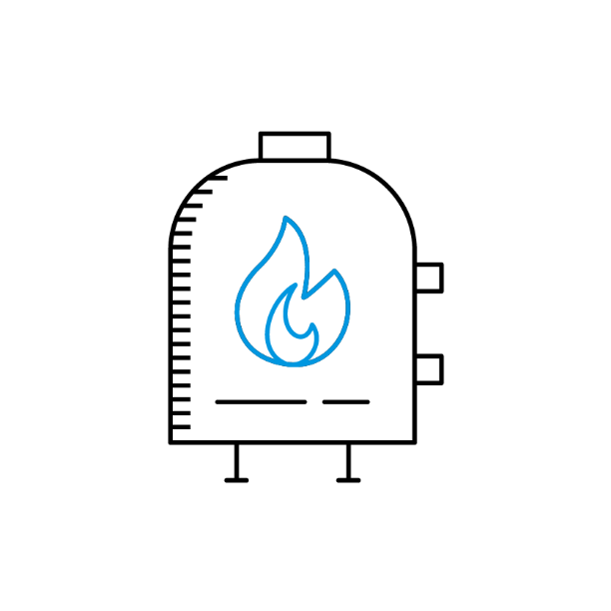
8 good reasons to choose it
1
Use of a fully
natural refrigerant
2
Daikin Safety Shield with integrated safety functions
3
Modular multi‑array architecture
4
Ideal for boiler
replacement projects

Slide 19

8 good reasons to choose it
1
Use of a fully
natural refrigerant
2
Daikin Safety Shield with integrated safety functions
3
Modular multi‑array architecture
5
4
Plug‑and‑play installation
Ideal for boiler
replacement projects

Slide 20

8 good reasons to choose it
1
Use of a fully
natural refrigerant
2
Daikin Safety Shield with integrated safety functions
6
3
High installation flexibility
Modular multi‑array architecture
5
4
Plug‑and‑play installation
Ideal for boiler
replacement projects

Slide 21


8 good reasons to choose it
1
Use of a fully
natural refrigerant
7
2
Inverter‑driven scroll compressors and EC brushless fans
Daikin Safety Shield with integrated safety functions
6
3
High installation flexibility
Modular multi‑array architecture
5
4
Plug‑and‑play installation
Ideal for boiler
replacement projects

Slide 22

8 good reasons to choose it
8
1
iCM improves energy efficiency & reduces overall energy consumption
Use of a fully
natural refrigerant
7
2
Inverter‑driven scroll compressors and EC brushless fans
Daikin Safety Shield with integrated safety functions
6
3
High installation flexibility
Modular multi‑array architecture
5
4
Plug‑and‑play installation
Ideal for boiler
replacement projects

Slide 23

Scan the QR code
to download the presentation

