Slide 2
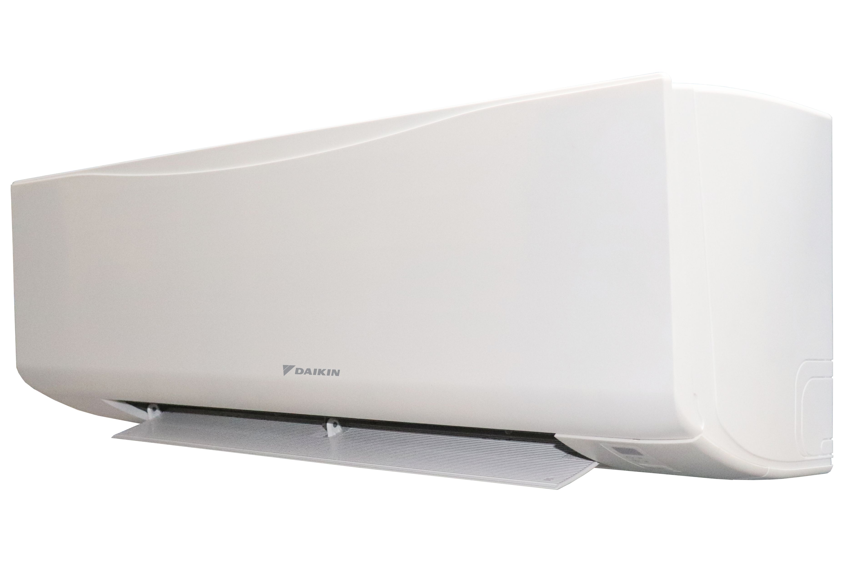
Daikin FWT-HTV Hi-Wall fan coil
Comfort, efficiency, and best-in-class indoor air quality

Slide 3
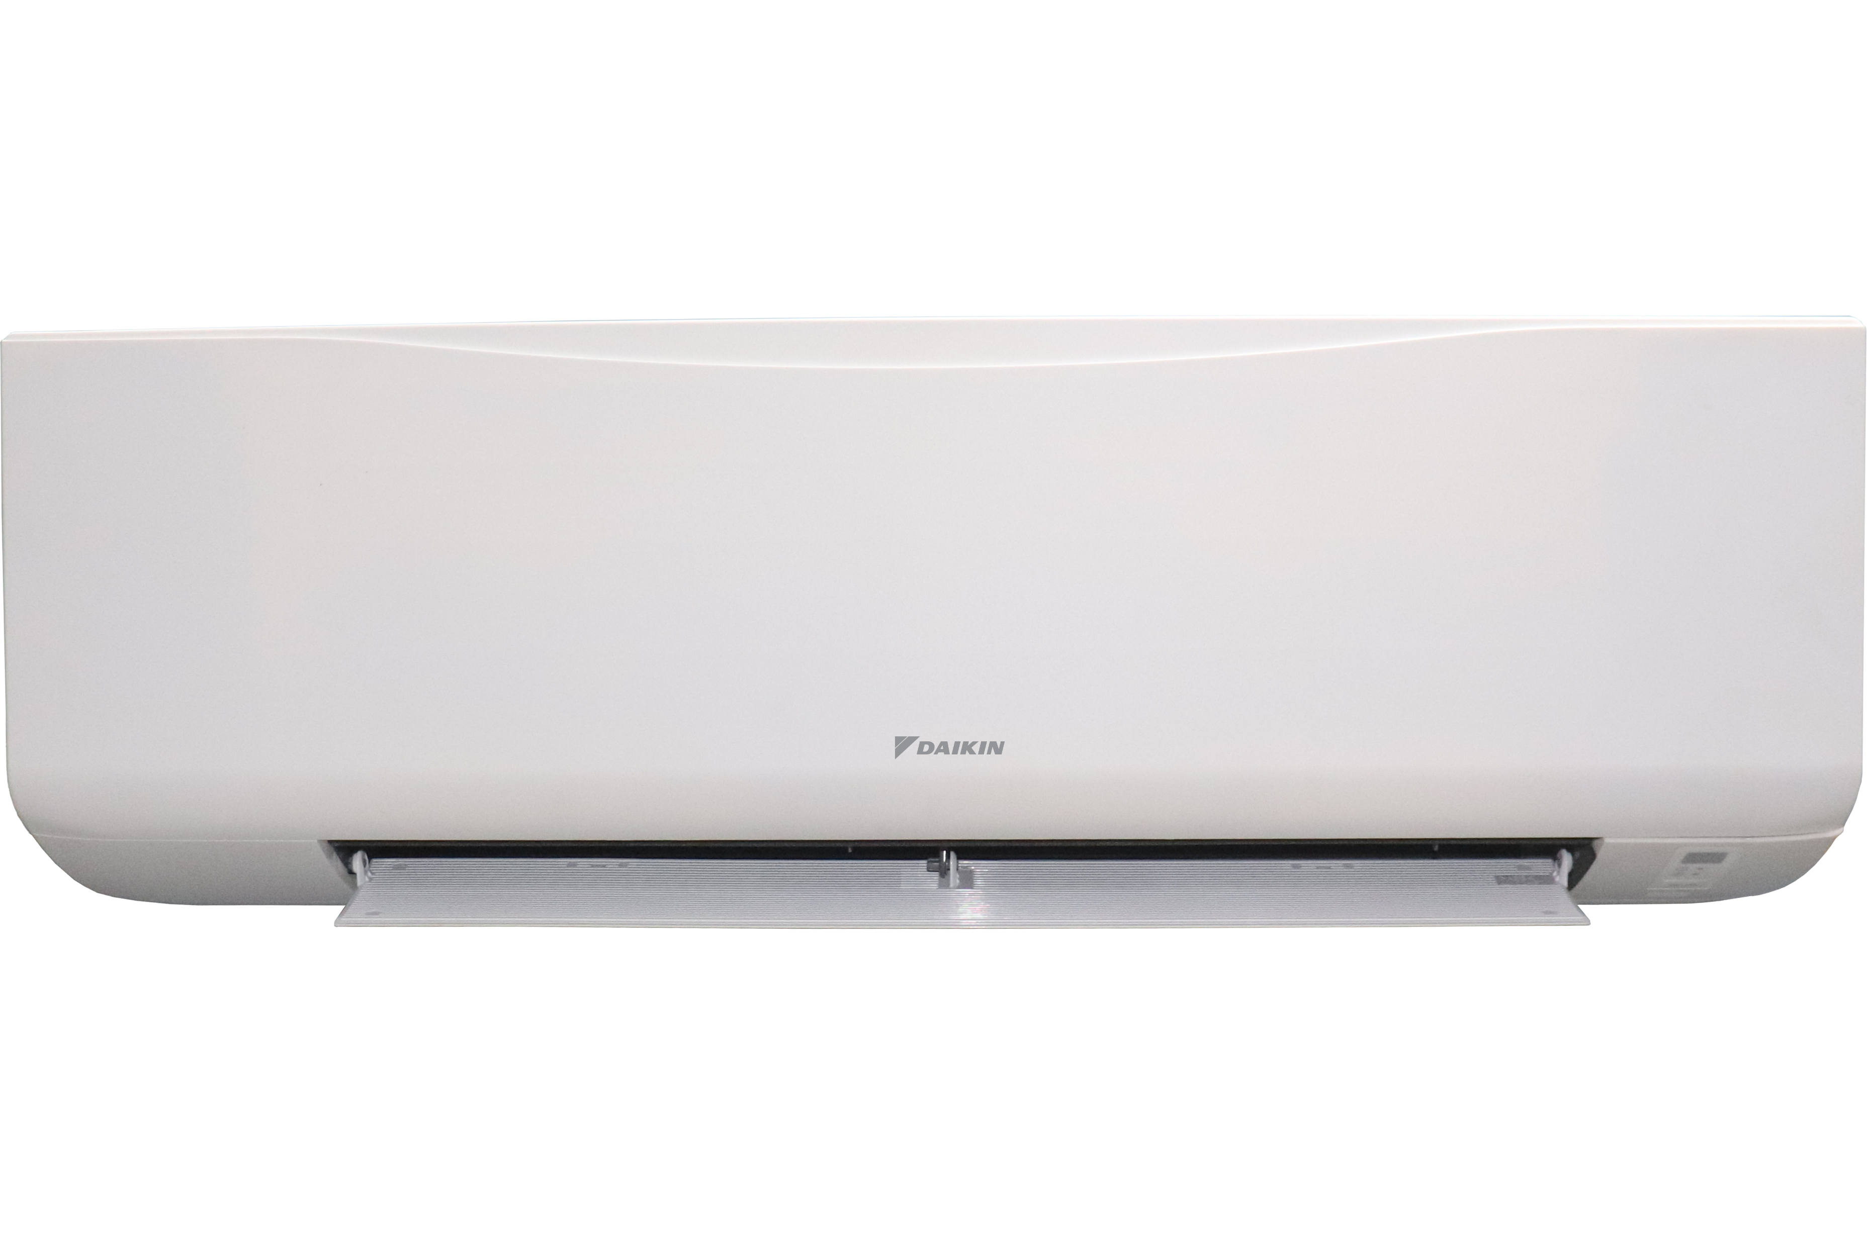
8 good reasons to choose it

Slide 4
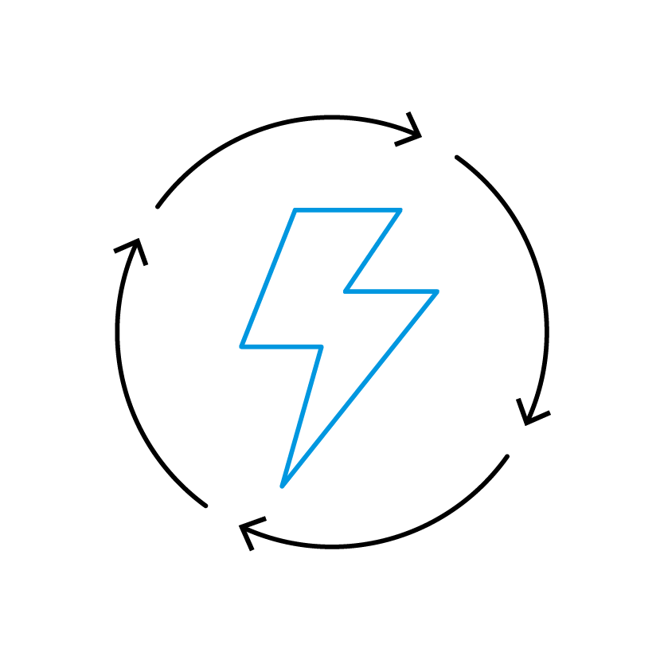
8 good reasons to choose it
#1
Highly efficient & quiet BLDC fan motor

Slide 5

8 good reasons to choose it
#1
Highly efficient & quiet BLDC fan motor
#2
Integration of a built-in 3-way on/off valve improving system performance

Slide 6

8 good reasons to choose it
#1
Highly efficient & quiet BLDC fan motor
#2
Integration of a built-in 3-way on/off valve improving system performance
#3
Purified indoor air

Slide 7


8 good reasons to choose it
#1
Highly efficient & quiet BLDC fan motor
#2
Integration of a built-in 3-way on/off valve improving system performance
#3
Purified indoor air
#4
Compliant with LEED and BREEAM protocols

Slide 8

8 good reasons to choose it
#1
Highly efficient & quiet BLDC fan motor
#2
Integration of a built-in 3-way on/off valve improving system performance
#3
Purified indoor air
#5
Quiet & Sleep mode for comfortable environment
#4
Compliant with LEED and BREEAM protocols

Slide 9

8 good reasons to choose it
#1
Highly efficient & quiet BLDC fan motor
#2
Integration of a built-in 3-way on/off valve improving system performance
#6
Fan Stop Control to optimize comfort
#3
Purified indoor air
STOP
#5
Quiet & Sleep mode for comfortable environment
#4
Compliant with LEED and BREEAM protocols

Slide 10

8 good reasons to choose it
#1
Highly efficient & quiet BLDC fan motor
#7
Instant cooling
#2
Integration of a built-in 3-way on/off valve improving system performance
#6
Fan Stop Control to optimize comfort
#3
Purified indoor air
#5
Quiet & Sleep mode for comfortable environment
#4
Compliant with LEED and BREEAM protocols

Slide 11

8 good reasons to choose it
#8
Self-diagnosis to detect any faults or malfunctions in the system
#1
Highly efficient & quiet BLDC fan motor
#7
Instant cooling
#2
Integration of a built-in 3-way on/off valve improving system performance
#6
Fan Stop Control to optimize comfort
#3
Purified indoor air
#5
Quiet & Sleep mode for comfortable environment
#4
Compliant with LEED and BREEAM protocols

