Slide 2
From Chiller to Building
What is changing and will change in the HVAC Market

Slide 3
New EPBD directive and its impact on the HVAC system
Energy Performance of Buildings Directive (EPBD)
Smart Control System

Slide 4
Energy Performance of Buildings Directive (EPBD)

Slide 5
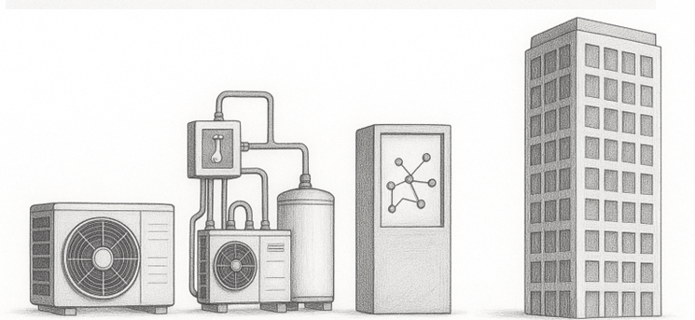
Energy Performance of Buildings Directive
The Energy Performance of Buildings Directive (EPBD) shifts the focus to the overall performance of the building. The improved performance of the building will depend on the Unit's performance, the Thermal plant's efficiency, and the monitoring level of the BMS System.
EPBD - Directive (UE) 2024/1275 Main target:
Zero-Emission Buildings* (ZEB) by 2050
New public building by 2028
New Building by 2030
Minimum Energy Performance Requirements (MEPS)
New Tools for Requalification and Monitoring
Building Renovation Passport
Smart Readiness Indicator, SRI
Automation and continuous monitoring systems (BACS) to ensure high efficiency
EPBD Target
*A zero-emission building must have very high energy performance and produce no direct emissions from fossil fuels

Slide 6

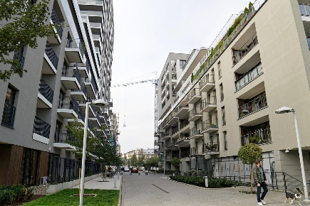
Energy Performance of Buildings Directive
New Buildings - Digital & green by design
Passive, renewable and fully prepared building for smart control from the day of opening.
Non-residential buildings with systems larger than 70 kW, designed today, must include a compliant BACS to fulfil the requirement by 2029.
Residential buildings (especially collective houses) built from 2026 onward will need to be equipped with smart systems for monitoring and regulation of consumption.

Slide 7


Energy Performance of Buildings Directive
Existing Buildings
Non-residential buildings with thermal systems over 290 kW, such as hospitals and shopping malls, will be required to have a BACS automation system installed.
Smaller buildings, with systems above 70 kW, will have until the end of 2029 to comply.
For residential buildings, there is no mandatory requirement; however, each country must submit a national renovation plan by May 2026. Renovation will be encouraged through appropriate government measures, such as incentives.

Slide 8
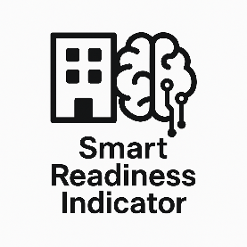
Smart Readiness Indicator
Smart Readiness Indicator (SRI) is a rating system that assesses a building’s ‘intelligence,’ measuring its ability to use smart technologies and automation systems to enhance energy efficiency and facility management.
The European Commission will report on SRI trials by 2026 and is expected to prepare legislation by 2027 to make SRI mandatory for large non-residential buildings.
EPBD - Deadlines and Implementation in Member States
Partial transposition by January 1, 2025
Transposition Complete by May 29, 2026

Slide 9
2. Building Automation and Control Systems (BACS)

Slide 10


Building Automation and Control Systems (BACS) - Definition
BACS are automation and control systems that automatically monitor, regulate and optimise a building’s technical functions, including heating, cooling, ventilation, lighting, and more.
Main Target
Improving energy efficiency and occupant comfort through intelligent control of technical systems.
BACS

Slide 11


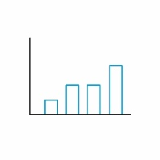
Building Automation and Control Systems (BACS)
Main features
Continuous monitoring - They must record and analyse energy consumption, allowing diagnosis of inefficiencies.
Interoperability - They must be able to communicate with other systems (e.g., lighting management, security, photovoltaics) via standard protocols (BACnet, Modbus, KNX, etc.).
Predictive and adaptive function - Modern BACS integrate algorithms that adapt system operation to weather conditions, actual usage, and external signals.

Slide 12
2. Smart Control System

Slide 13

Smart Control System
Smart Control System is a HVAC building management system fully designed to comply with the EPBD directive.
Efficiency, simplicity, and seamless integration for HVAC systems, including chillers, fan coils, and AHUs.
Key benefits
Energy savings through dynamic staging and reset algorithms
Control flexibility (manual or automatic)
Integrated water-side + air-side management
Real-time visualisation: performance, histories, alarms
Smart Control System

Slide 14
Smart Control System
The classification of Building Automation and Control Systems (BACS) is established by the EPBD (EU) Directive 2024/1275 and the technical standards EN 15232-1:2017 and EN ISO 52120-1:2022.
Automation systems are categorised into four energy efficiency classes:
Class type | Description | Automation level
Class D – Non-energy-efficient | No control or automation. Manual operation of systems (e.g., local thermostats not connected to a central system). | None
Class C – Standard (Baseline) | Basic automation: local control (per room or zone) without central supervision. | Low
Class B – Advanced | Centralized supervision and automatic coordinated control of heating, cooling, ventilation, and lighting. Optimization based on presence, outdoor temperature, and schedules. | Advanced
Class A – High Energy Performance | Smart system with predictive functions, self-learning, and dynamic management based on real data (occupancy, weather, tariffs). Integrated with other systems (smart grids, IoT, EPMS). | Very advanced / Smart Building

Slide 15

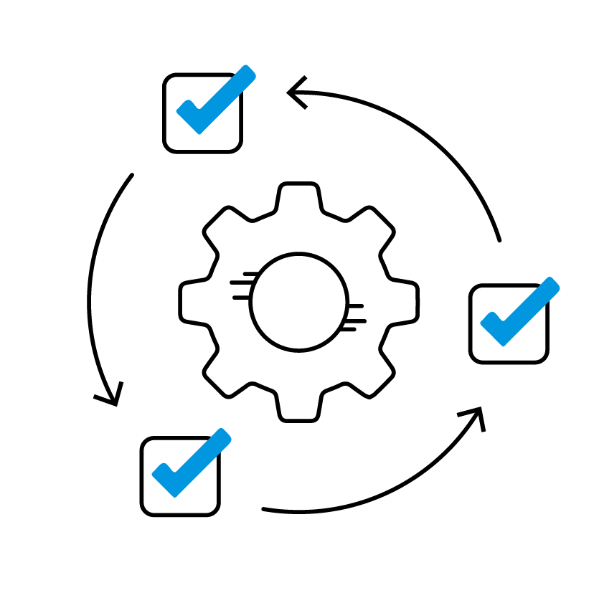
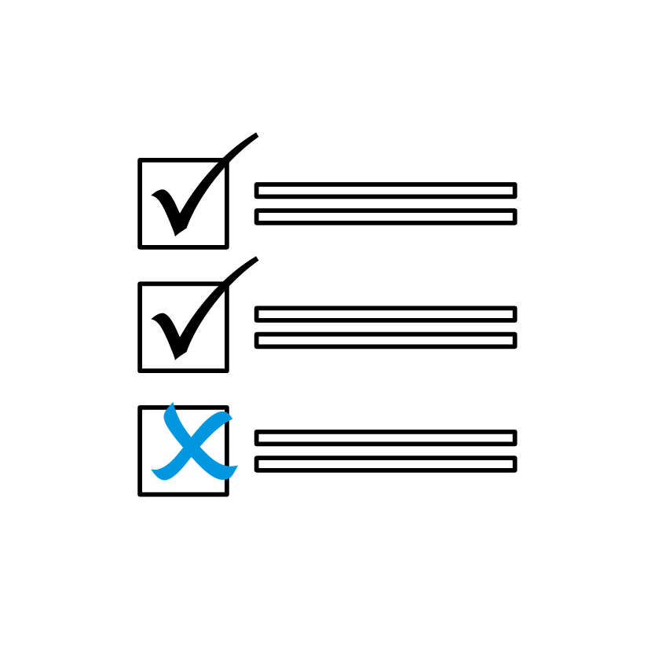

Smart Control System
Smart Control System respects the main requirement of the BACS.
The automation level can be considered “advanced” fully compliant with Class B
Continuous
monitoring
Predictive &
adaptive function
Interoperability
100%
100%
50%
Data Logging & Reporting
100%
Automatic Control & Optimization
Fault Detection & Diagnostics
User Interface &
Management Functions
75%
75%
100%

Slide 16
Smart Control System
Plant-room functions
Application
Chilled/heated water temperature optimization
Dynamic chiller and pump sequencing
Primary and secondary management with VFD
Intelligent defrost management for heat pumps
Shopping malls
Hotels and resorts
Universities and schools
Hospitals and health facilities
Airports
Smart Control System
Air-side functions
User interface
Supervision of AHUs, FCUs and zone controllers
Pre-heating/cooling, after-hours cooling/heating, freeze protection
Scheduling and occupancy monitoring
Access via web browser (PC/tablet)
User-friendly dashboard with widgets on performance, load, COP, alarms
Three levels of access: Dashboard, PlantManager, Configurator

Slide 17
8 good reasons to choose Daikin Smart Control System
Smart Control System

Slide 18

The best configuration to optimize performances
#1
Developed by Daikin for superior performance

Slide 19
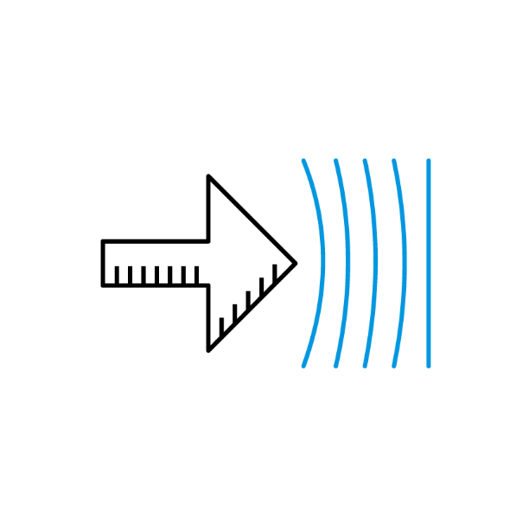
Flexibility that fitting every need
#1
Developed by Daikin for superior performance
#2
Flexible & easily adaptable solution

Slide 20

Turnkey solutions for plant designers
#1
Developed by Daikin for superior performance
#2
Flexible & easily adaptable solution
#3
Complete Turnkey solution

Slide 21
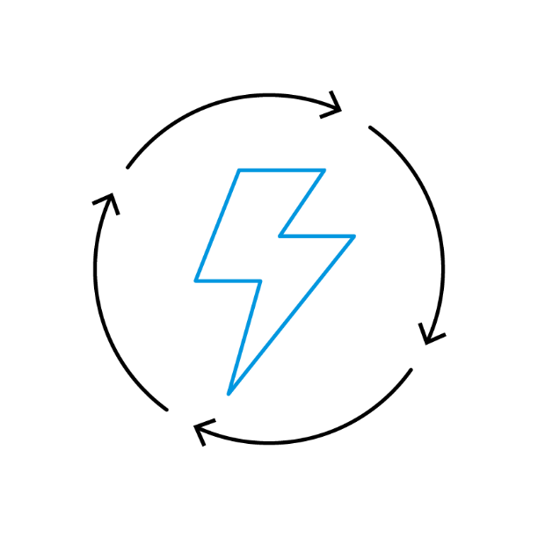
Smart plant management for maximum comfort efficiency
#1
Developed by Daikin for superior performance
#2
Flexible & easily adaptable solution
#3
Complete Turnkey solution
#4
Optimal performance
under any condition

Slide 22
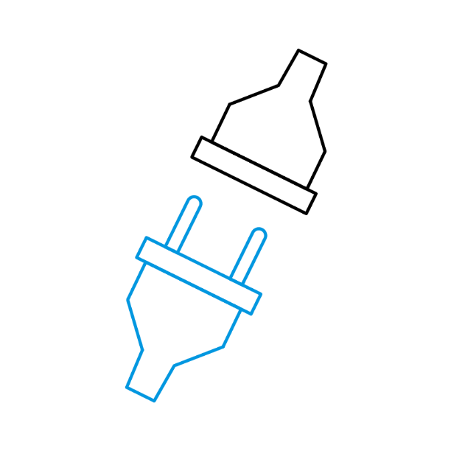
Simple, efficient, and ready to use
#1
Developed by Daikin for superior performance
#2
Flexible & easily adaptable solution
#3
Complete Turnkey solution
#5
Plug & play: simple & fast Installation
#4
Optimal performance
under any condition

Slide 23

Smart architecture for superior performance
#1
Developed by Daikin for superior performance
#2
Flexible & easily adaptable solution
#6
Smart system architecture
#3
Complete Turnkey solution
#5
Plug & play: simple & fast Installation
#4
Optimal performance
under any condition

Slide 24

Enhanced reliability
#1
Developed by Daikin for superior performance
#7
Enhances overall system reliability extending lifespan
#2
Flexible & easily adaptable solution
#6
Smart system architecture
#3
Complete Turnkey solution
#5
Plug & play: simple & fast Installation
#4
Optimal performance
under any condition

Slide 25

Quick and cost-effective implementation
#8
Fast implementation
#1
Developed by Daikin for superior performance
#7
Enhances overall system reliability extending lifespan
#2
Flexible & easily adaptable solution
#6
Smart system architecture
#3
Complete Turnkey solution
#5
Plug & play: simple & fast Installation
#4
Optimal performance
under any condition

Slide 26
Plant Configurations
The Smart Control System is available in 3 main configurations, and each version can manage up to four chillers or heat pumps, with a combined cooling capacity of up to 500 kW, along with additional equipment.
Light | Medium | Full
Up to 500 datapoints | Up to 1,250 datapoints | Up to 2,500 datapoints
Up to 20 fan coil zones or 10 AHUs | Up to 70 fan coil zones, or 10 AHUs + 50 fan coil zones | Up to 120 fan coil zones, or 10 AHUs + 100 fan coil zones
Ideal for small buildings or single zones | Ideal for medium-size buildings or multiple floors | Ideal for large facilities or multiple systems
*Each fan coil zone can include up to 30 fan coils, managed via a dedicated controller developed and supplied by Daikin.

Slide 27
Plant management
All the hydronic systems are available with pumps both in dedicated and manifolded configuration, ensuring a modular design that allows the management of multiple circuits or zones using a single main pump and distribution manifolds.
The plant layouts that can be managed are:
Constant Primary: ​It operates at a continuous flow rate
Variable Primary Only: ​The system modulates the flow rate based on the delta pressure
Constant Primary / Variable Secondary: ​The primary circuit maintains a constant flow rate, while the secondary circuit varies the​ flow according to the load

Slide 28
Product coverage
SCS can manage plants composed of various Daikin equipment, offering full flexibility to cover a wide range of applications and installations.
Chillers & Heat Pumps
Air Handling Units
Fan coil units
Decentralised ventilation systems
Cassette:
FWH-A, FWI-A, FWC-D, FWF-D
Ducted:
FWP-C, FWB-C, FWD-A, FWN-A, FWE-F, FWE-D
Floor-standing:
FWZ-A, FWV-D
Flexi:
FWR-A, FWL-D, FWS-A, FWM-D
EWAT-CZ (air-cooled chillers)
EWYT-CZ (air-to-water heat pumps)
Equipped with Daikin Inverter scroll compressors
Using R-32 refrigerant
Capacity range: 16 – 90 kW (standard design conditions)
Compact T
Available in 5 sizes
Airflow: 200 – 4200 m³/h
Compact L
Ideal for floor-ceiling applications
Available in 6 sizes (02 - 07)
Airflow: 150 – 4000 m³/h

